Slide 1


Assignment – 4 Sentiment Analysis
Anuj Rathod – 200543277
Siddharth Trivedi - 200543275

Slide 2
Introduction
This presentation delves into the intriguing realm of sentiment analysis, utilizing the extensive Sentiment140 dataset. Comprising 1.6 million tweets sourced from Twitter, a widely-used social media platform, this dataset serves as a robust foundation. Sentiment analysis, alternatively termed opinion mining, employs techniques from natural language processing, text analysis, and computational linguistics to discern and extract subjective insights from various textual sources.
Dataset Link: https://www.kaggle.com/datasets/kazanova/sentiment140
The Sentiment140 dataset, initially employed in a Stanford University research endeavor, comprises Twitter posts categorized automatically as either positive or negative. This categorization relies on the detection of emoticons within the tweets.

Slide 3
Sentiment Analysis on Twitter Data
Regarding Python Process:
We employ Python, a robust programming language renowned for its readability and adaptability in data analysis endeavors, to preprocess and scrutinize the data. This procedure encompasses the subsequent stages:
Data Cleaning: Eliminate superfluous columns, address missing data, and refine the tweet text (eliminate special characters, URLs, digits, etc.).
Text Preprocessing: Segment the text (divide it into individual words) and eliminate stop words (commonly occurring words such as 'the', 'is', 'in', etc.).
Vectorization: Convert the preprocessed text into a numerical format intelligible to machine learning algorithms. We opt for the Bag of Words model for this objective.
Model Training: Train a logistic regression model employing the vectorized text.
Evaluation: Assess the model's performance utilizing metrics such as accuracy, precision, recall, and F1-score.

Slide 4


Objectives
Comprehend the data: The primary aim is to grasp the characteristics and organization of the data within the Sentiment140 dataset. This entails examining the data's distribution, its types (numerical, categorical, textual), and identifying any anomalies or discrepancies present in the dataset.
Prepare the data: The subsequent goal is to preprocess and refine the data to ready it for subsequent analysis. This entails eliminating redundant features, refining textual data, addressing missing data, and converting text into a suitable format for machine learning algorithms.
Conduct Sentiment Analysis: The primary goal is to execute sentiment analysis on the dataset. This encompasses training a machine learning model to forecast the sentiment of a tweet according to its content. The model's efficacy is then assessed based on its capacity to predict sentiment accurately when presented with unseen data.
Offer Insights: Yet another crucial aim is to furnish insights derived from the analysis. This might involve elucidating the distribution of sentiments within the dataset, identifying prevalent words in positive and negative tweets, evaluating the accuracy of the sentiment prediction model, and so forth.
Visualize the Data: The goal is to depict the data and the outcomes of the sentiment analysis through visual means. This encompasses generating graphs and charts to illustrate the distribution of sentiments, word frequencies, model performance metrics, and other pertinent aspects.

Slide 5
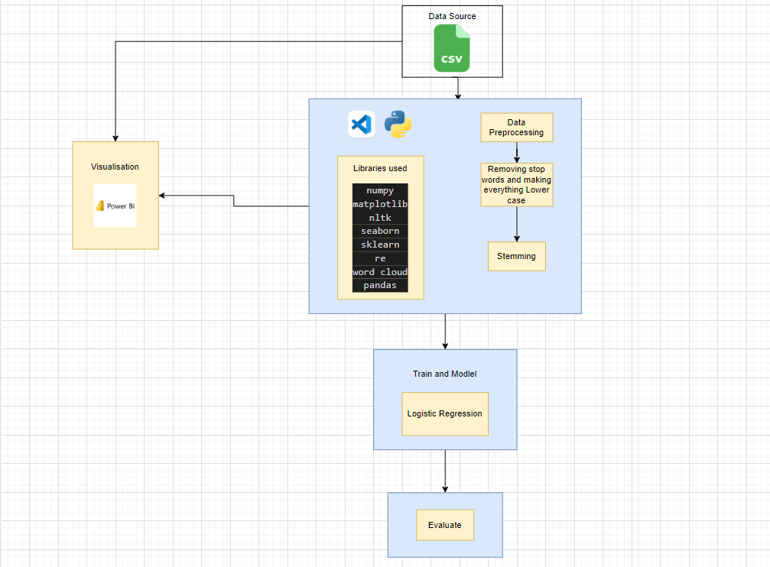
Architecture

Slide 6
Working of Architecture
Loading Dataset: The initial step involves loading the Sentiment140 dataset into a pandas DataFrame, leveraging the pandas.read_csv() function. Pandas serves as a data manipulation library within Python. The dataset includes fields such as polarity, ID, date, query, user, and tweet text.
Data Cleaning: Following data loading, the cleaning process commences. Here, redundant columns are eliminated using the pandas.drop() function. Columns like 'ID', 'date', 'query', and 'user' are deemed unnecessary for the sentiment analysis task and hence removed. The 'polarity' column is relabeled as 'target', and its values are mapped from {0, 2, 4} to {Negative, Neutral, Positive}.
Preprocessing: Subsequently, the tweet text undergoes preprocessing. This involves:
Eliminating special characters, numbers, and URLs using regular expressions.
Tokenizing the text (splitting it into individual words) using nltk.word_tokenize() function.
Removing stop words (commonly used words like 'the', 'is', 'in', etc.) with the help of the NLTK library's English stop words list.
Applying stemming (reducing words to their root form) using the Porter Stemmer from the NLTK library.
Data Splitting: The dataset is partitioned into training and testing sets using the train_test_split() function from the sklearn library. This facilitates model performance validation.

Slide 7
Pros of Sentiment Analysis
Reveal Insights: Sentiment analysis has the capability to unveil hidden patterns and trends that might escape casual observation. It can discern overarching trends in sentiment, highlight pivotal topics eliciting positive or negative reactions, and pinpoint fluctuations in sentiment over time.
Scalability: Sentiment analysis empowers businesses to efficiently analyze extensive datasets that would be unmanageable to review manually. It serves as a potent tool for managing the immense volume of data generated across social media platforms.
Real-time Analysis: Sentiment analysis enables businesses to conduct analyses in real time, enabling swift responses to fluctuations in public opinion or timely reactions to customer feedback.
Customer-focused Approach: Sentiment analysis aids in comprehending customer sentiment and feedback, facilitating businesses in aligning their products and services more effectively with customer requirements and preferences.

Slide 8
Cons of Sentiment Analysis
Contextual Comprehension: Sentiment analysis algorithms may encounter challenges in grasping context, irony, sarcasm, and other subtleties inherent in human language. Consequently, this can result in inaccuracies in sentiment classification.
Data Integrity: The accuracy of the analysis hinges significantly on the quality of the data. Should the data exhibit bias or incompleteness, the outcomes of sentiment analysis are likewise compromised.
Language Constraints: Certain sentiment analysis tools may not offer support for all languages, potentially restricting their utility in a multilingual environment.

Slide 9

Business Impact on Sentiment Analysis
Enhanced Customer Support: Utilizing sentiment analysis enables businesses to monitor real-time customer feedback, swiftly identify issues, and promptly address them, thereby enhancing overall customer satisfaction and fostering loyalty.
Product Enhancement: Through the analysis of customer sentiment, businesses can pinpoint areas of improvement or innovation in their products, leveraging customer feedback to drive enhancements and develop new offerings.
Refined Marketing and Sales Strategies: Insight into customer sentiment informs more effective marketing and sales tactics. Positive sentiment can guide intensified promotional efforts, while negative sentiment signals the need for strategic adjustments.
Brand Management: Continuous sentiment monitoring empowers businesses to proactively manage their brand reputation. By promptly addressing shifts in public opinion and negative sentiment, they can safeguard and enhance their brand image.
Competitive Edge: By comprehending customer sentiment, businesses gain a competitive edge by swiftly responding to market trends and customer feedback, thereby staying ahead of competitors.

Slide 10
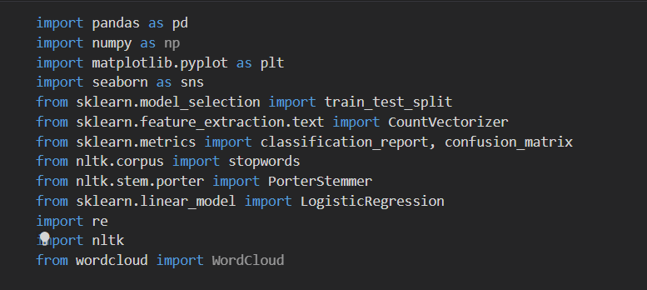
Libraries

Slide 11
Functionalities
pandas: This library offers efficient data structures and tools for data analysis, facilitating tasks such as loading datasets into DataFrames and conducting data manipulation operations such as column removal.
numpy: Numpy provides support for handling large, multi-dimensional arrays and matrices, accompanied by an extensive collection of mathematical functions tailored for array operations.
matplotlib and seaborn: These libraries are utilized for data visualization purposes, offering a range of functions for generating diverse plots and charts.
nltk: The Natural Language Toolkit (NLTK) serves as a comprehensive resource for text preprocessing tasks, encompassing functionalities such as text tokenization, stopword removal, and word stemming.
re: The re (regular expressions) library is employed for text processing tasks like the removal of special characters, numbers, and URLs from tweet texts.
sklearn: Scikit-learn furnishes a rich suite of machine learning algorithms and tools for data analysis tasks. It is instrumental in vectorizing text data, partitioning datasets into training and testing sets, training logistic regression models, and evaluating their performance.
WordCloud: This library is leveraged to generate visually appealing word cloud visualizations.

Slide 12
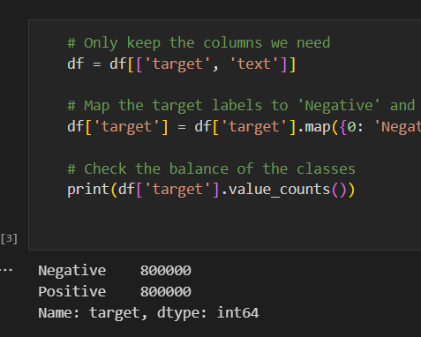

Data Analysis
Select Relevant Columns: df = df[['target', 'text']]
This command retains only the 'target' and 'text' columns in the DataFrame df while discarding the rest. The 'target' column denotes the sentiment of the tweet (negative or positive), and the 'text' column holds the actual tweet content.
Map Target Labels to 'Negative' and 'Positive': df['target'] = df['target'].map({0: 'Negative', 4: 'Positive'})
This statement modifies the values in the 'target' column. Initially, the 'target' column contains values 0 (indicating negative sentiment) and 4 (indicating positive sentiment). This line replaces 0 with 'Negative' and 4 with 'Positive' to enhance interpretability.
Assess Class Balance: print(df['target'].value_counts())
This code snippet examines the distribution of negative and positive sentiments within the dataset. The value_counts() function tallies the occurrences of each unique value in the 'target' column. It aids in determining whether the dataset exhibits balance (i.e., features a comparable number of negative and positive tweets) or if it's imbalanced. A balanced dataset typically leads to better model performance.

Slide 13
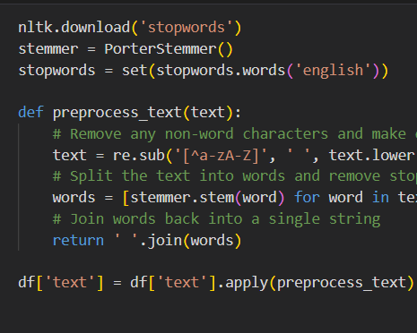
Data Preprocessing
Download Stopwords: nltk.download('stopwords')
This command fetches the collection of English stopwords (commonly occurring words like 'the', 'is', 'in', etc.) from the NLTK (Natural Language Toolkit) library
Define Preprocessing Function: def preprocess_text(text):...
This function receives a text string as input and executes several preprocessing actions:
It eliminates any non-alphabetic characters and converts all text to lowercase.
It splits the text into individual words.
It eliminates stopwords and performs stemming on the words.
It reassembles the processed words into a single string.
Apply Preprocessing Function to Text: df['text'] = df['text'].apply(preprocess_text)
This statement employs the preprocess_text function to each entry in the 'text' column of the DataFrame. The resulting processed text is then reassigned to the 'text' column, indicating its readiness for vectorization and further analysis.

Slide 14
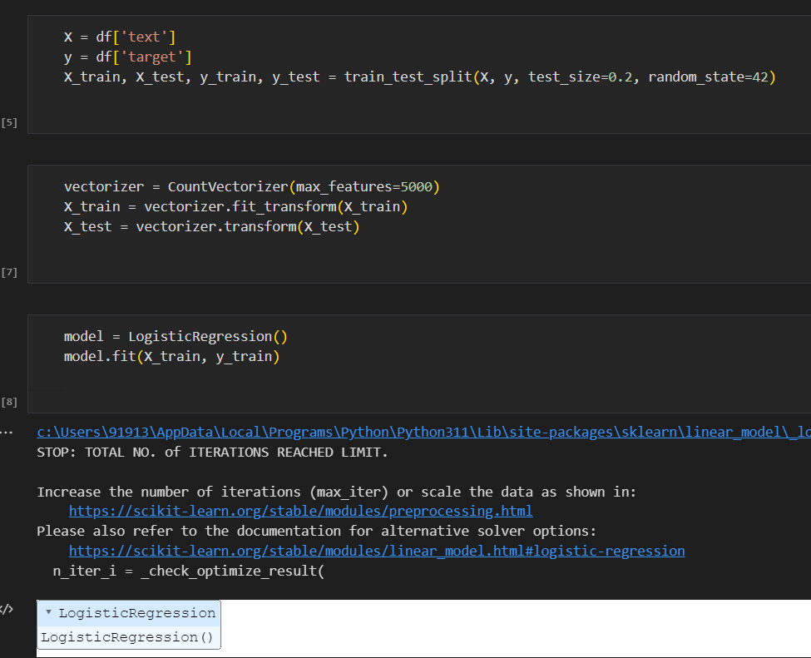
Model Testing and Training
Separate Features and Labels: X = df['text'], y = df['target']
The data is divided into features (X) and labels (y). X contains the 'text' column, representing the tweet text, which serves as the basis for predictions. Meanwhile, y contains the 'target' column, indicating the sentiment to predict.
Split Data into Training and Testing Sets: X_train, X_test, y_train, y_test = train_test_split(X, y, test_size=0.2, random_state=42)
The dataset is split into a training set and a testing set. 80% of the data is allocated for training the model, while 20% is reserved for evaluating its performance. The random_state parameter ensures reproducibility of the split across different runs.
Vectorize Text Data:
vectorizer = CountVectorizer(max_features=5000)
X_train = vectorizer.fit_transform(X_train)
X_test = vectorizer.transform(X_test)
These operations transform the text data into a numerical format suitable for machine learning algorithms. CountVectorizer constructs a 'bag of words' model, assigning integer IDs to words and counting their occurrences. Setting max_features=5000 limits the features to the 5000 most frequent words.
Train the Machine Learning Model:
model = LogisticRegression()
model.fit(X_train, y_train)
A Logistic Regression model is instantiated and trained using the training data. model.fit(X_train, y_train) is where the actual training takes place, establishing associations between tweet texts (X_train) and sentiments (y_train). Following this step, the model is prepared to make predictions.

Slide 15
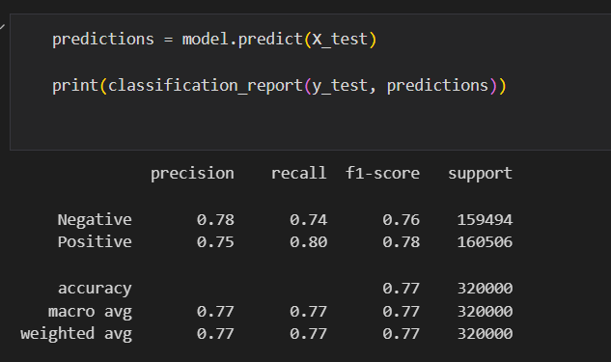
Evaluating the Model
Precision: Precision measures the classifier's ability to correctly identify positive instances without misclassifying negative ones. It's calculated as the ratio of true positives to the total predicted positives for each class. For example, a precision of 0.78 for the 'Negative' class indicates that 78% of the tweets predicted as negative were indeed negative.
Recall (Sensitivity): Recall assesses the classifier's ability to capture all positive instances. It's calculated as the ratio of true positives to all actual positive instances for each class. A recall of 0.74 for the 'Negative' class means that the model identified 74% of all actual negative tweets.
F1-score: The F1-score represents the harmonic mean of precision and recall, aiming to balance both metrics. It ranges from 0 to 1, with 1 indicating perfect balance. A F1-score of 0.76 for the 'Negative' class suggests a reasonably balanced performance in terms of precision and recall.
Support: Support denotes the actual number of occurrences of each class in the dataset. For 'Negative', a support value of 159494 signifies the presence of 159494 negative tweets in the dataset.
Accuracy: Accuracy measures the overall correctness of predictions, calculated as the ratio of correctly predicted observations to the total observations. An accuracy of 0.77 indicates that the model accurately predicted the sentiment 77% of the time.
Macro Average: The macro average computes metrics independently for each class and then averages them, treating all classes equally irrespective of their distribution in the dataset.
Weighted Average: The weighted average calculates metrics for each label, taking into account their frequency (support), which is particularly useful in handling class imbalances.

Slide 16
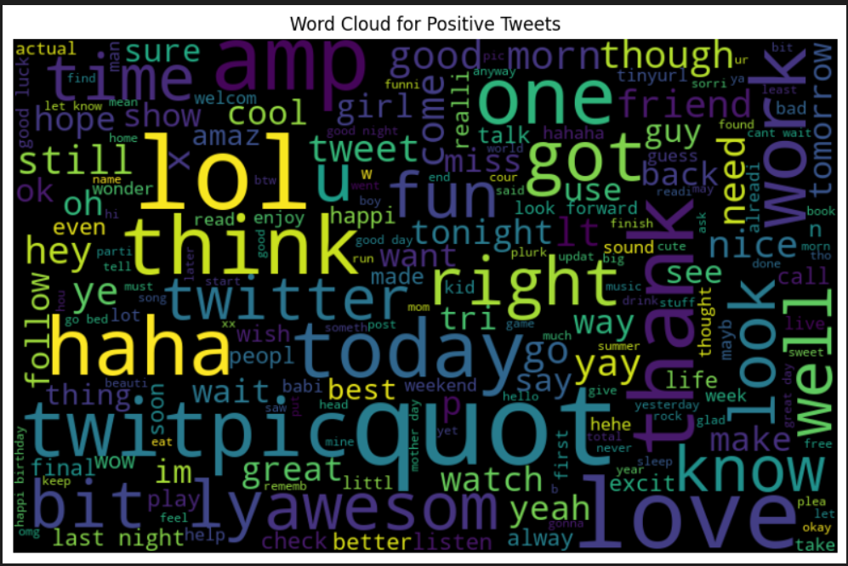
Output Positive Tweets

Slide 17
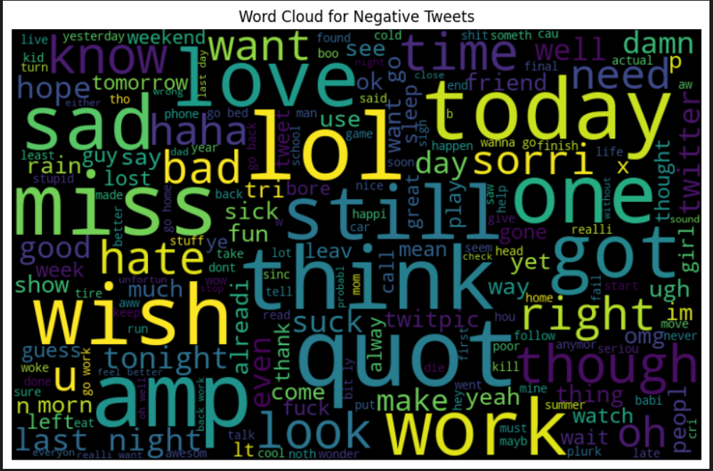
Output Negative Tweets

Slide 18

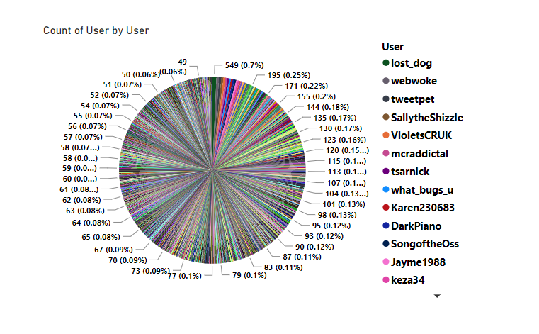
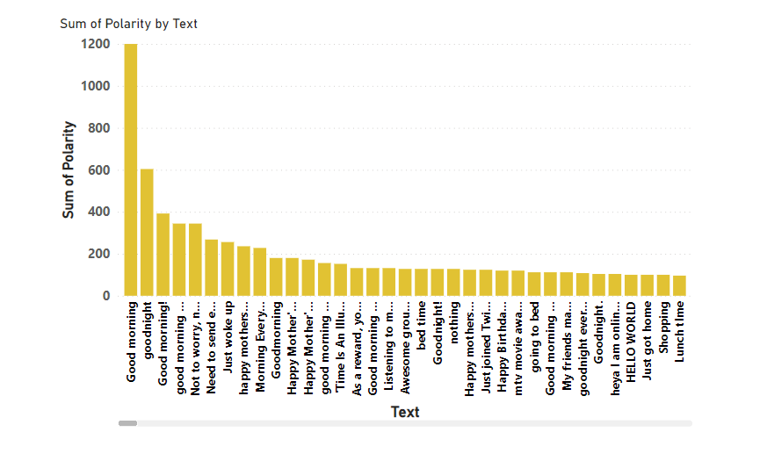
Power BI Visuals

Slide 19
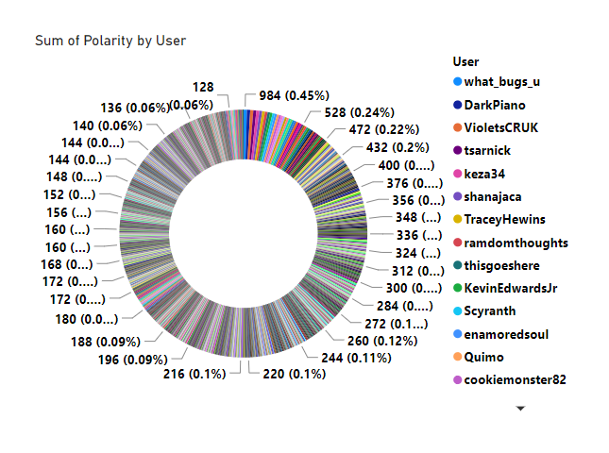
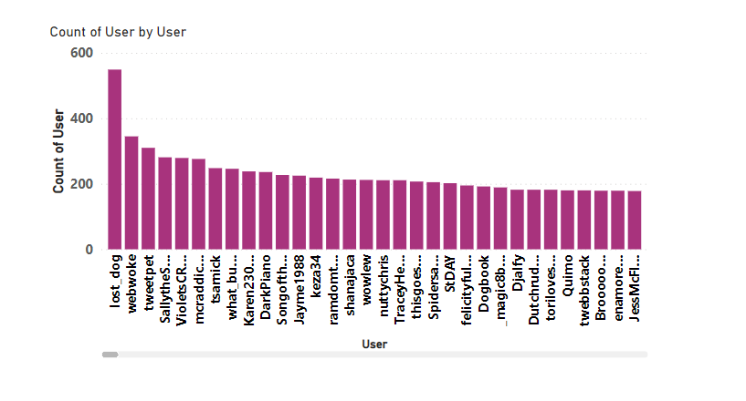
Power BI Visuals

Slide 20

GitHub Link
https://github.com/AnujR273/Sentiment-Analysis

Slide 21

Project Findings
The model achieved a commendable accuracy rate of 77% in determining the sentiment (positive or negative) of tweets.
Furthermore, precision, recall, and F1-score metrics underscored its strong performance, showcasing its ability to accurately classify both positive and negative tweets.
Employing logistic regression, the model showcased the efficacy of machine learning methods in conducting sentiment analysis, even on extensive and unstructured text datasets such as tweets.

Slide 22
Future Scope
While the model exhibited satisfactory performance, there exist opportunities for further enhancement and exploration:
Exploring more sophisticated NLP techniques and models, such as word embeddings like Word2Vec or GloVe, or advanced transformers like BERT or GPT-3, could potentially elevate the accuracy of sentiment analysis.
Deep learning methods like Recurrent Neural Networks (RNNs) or Long Short-Term Memory (LSTM) networks could be leveraged to better capture the context and semantics inherent in tweets.
Integrating mechanisms to handle negations and sarcasm could refine the model's comprehension of tweet content.
Expanding the model to encompass multi-class sentiment analysis (e.g., very negative, negative, neutral, positive, very positive) or emotion detection (e.g., happy, sad, angry, etc.) could provide more nuanced insights.
Furthermore, implementing real-time sentiment analysis would enable the continuous monitoring of sentiments across social media platforms.

Slide 23

Conclusion
The project effectively showcased the utilization of machine learning and NLP methodologies for conducting sentiment analysis on an extensive Twitter dataset. Despite the complexities associated with handling and interpreting unstructured text data, the model attained commendable performance metrics, affirming the efficacy of these methodologies in deriving valuable insights from such data. With further refinements and broadening of scope, sentiment analysis models like these hold considerable promise across diverse domains, spanning from business and marketing to public policy and mental health.

